Slide 1


CSED - 332
Final Presenation
Distributed Sorting using Scala + gRPC
Team Blue

Slide 2












CSED - 332
after Mid-progress
Acknowledgement
Solo Project
Fixed Milestones
Only one worker on project "Me"
Only simple gRPC connection test was finished. Goal set to "At least make something work"
We haven't designed
at all!
2

Slide 3








CSED - 332
Overall Progress
Sampling
Partitioning
Sorting
Shuffling
Merging
Fault Tolerance
Not
Implemented
Successful under non-risky conditions
3

Slide 4




CSED - 332
partitionPlan
localWorkerId
workerEndpoints
inputFiles / outputDir / tempDir
masterEndpoint
partitionTemp
partitionCounts
Overall Architecture
workers:
expectedWorkers
samples
partitionPlan
shuffleDoneWorkers
mergeDoneWorkers
Worker
Master
Worker
Server
Main
Main
Server
register
register
reply
send sample
send sample
reply
Ack
Ack
sendPartitionPlan
sendPartitionPlan
Future {streamShuffle}
Future {streamShuffle}
planAck
planAck
partitionChunk, chunkAck
partitionChunk, chunkAck
ShuffleDone
ShuffleDone
ShuffleDoneAck
ShuffleDoneAck
StartMerge
StartMerge
Future {mergeAndWrite}
Future {mergeAndWrite}
StartMergeAck
StartMergeAck
MergeDone
MergeDone
MergeDoneAck
MergeDoneAck

Slide 5


















CSED - 332
Overall Architecture
*gRPC message Limit: 4MB
2
1
2
read block
add leftover bytes
Worker 1
Leftover
Leftover
File Block
File Block
3.5MB
Store record in partition buffer
3.5MB
Buffer
Buffer
4
4
if not:
if not:
restore it as records, sort and divide into run files, then k-way merge
send to responsible worker (partitionChuck grpc)
3
if responsible:
append to local .tmp as byte stream(spill)
.run.1
.run.2
.run.n
.tmp
.tmp
Worker 2
Worker 2
However if worker crashes, remaining .tmp might be reused and lead to error

Slide 6

CSED - 332
How to run this program
jar file created by sbt assembly
332project-assembly-0.1.0-SNAPSHOT.jar
Master run command
java -jar <jar file name> master.MasterMain <#workers>
Worker run command
java -jar <jar file name> worker.WorkerMain <masterHost:port> -I <inputDir> -O <outputDir>
Or just run shell file in master server
distributed sorting
./run_workers.sh <number of workers> <input dataset> e.g.: ./run_workers.sh 3 small
data validation testing
./test_valsort.sh <number of workers> <input dataset> e.g.: ./test_valsort.sh 3 small
6

Slide 7
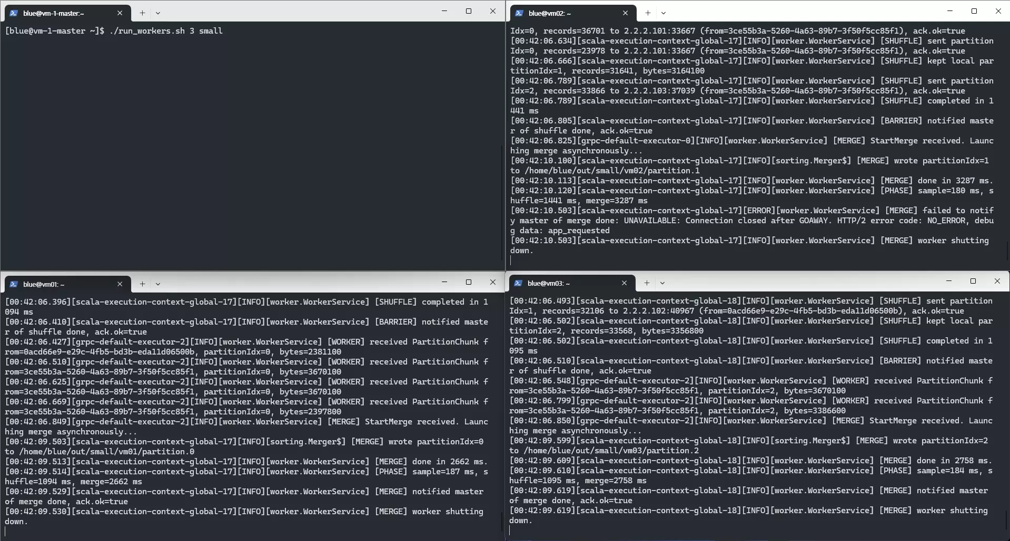
Progress Overview
Simple Demo
(3 workers, using small dataset)
7

Slide 8
CSED - 332
Correctness Evaluation
1. Does the master print a sequence of workers? | Only in log
2. Is the output sorted in each worker? | Yes
3. # of records in the input == # of records in the output? | Yes so far
Discovered Errors (so far)
(Mostly on large datasets) Output record count drops.
Worker logs show send failure despite MergeAck.
Leftover .tmp after merge crash may be read on next run.
8

Slide 9
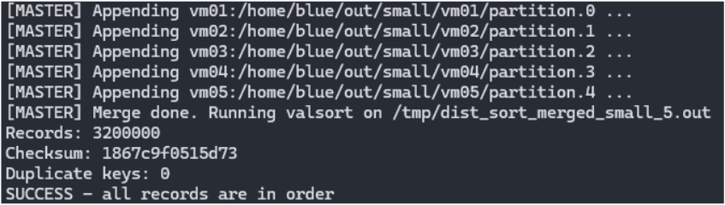
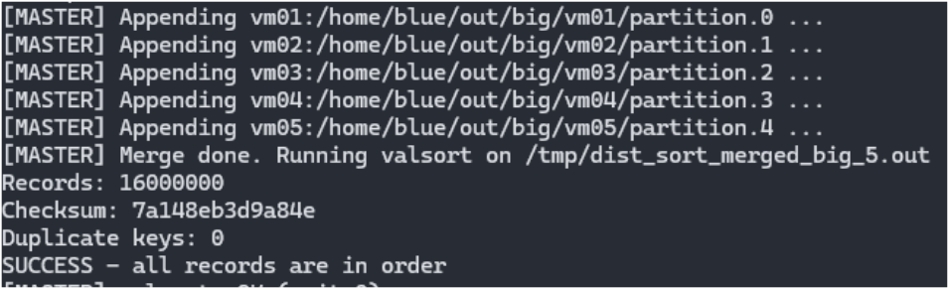
CSED - 332
Results
test settings | time(after registration) | valsort
small, 5 workers | 9047ms | O
2. big, 5 workers | 167041ms | O
9

Slide 10
CSED - 332
Why this project fell short
Rushed implementation led to missing key requirements
Insufficient testing
AI took the surgeon role
No teammates
Overall: planning & design were the main gaps

